Slide 1


Welcome to Fishermen Class

Slide 2

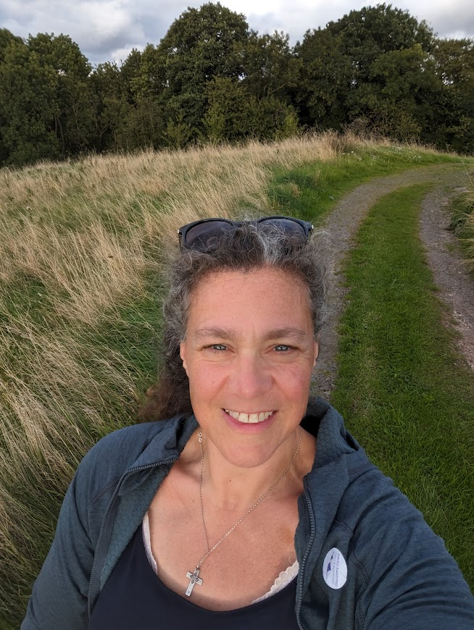
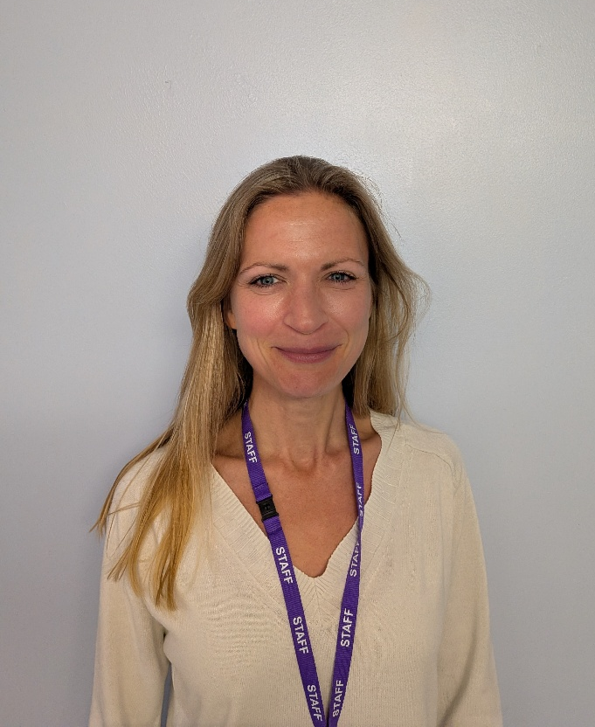
Who are your teachers?
Mrs Fiona Clipson
Class Teacher Fisherman Class
EVC Co-Ordinator
Science Co-ordinator
Forest School Lead
Mrs Katie Hooper
Teaching Assistant Fishermen Class
Monday – Friday AM

Slide 3
St Mary’s Staff
Mrs L. Concannon
Headteacher and Designated Safeguarding Lead
RE Lead
Art and Design Lead
Carpenters Class Teacher Yr 3/4
Mrs D. Morgan
Shepherds / Carpenters Class Teacher
Senior Teacher/SENCO
Well-Being support
Mrs F. Clipson
Fishermen Class Teacher Yr1/2
EVC Co-Ordinator
Science Lead
Forest School Lead
Mrs S. Vale
Farmers Class Teacher N and R
English Lead
Early Years Lead
Deputy Designated Safeguarding Lead
Mr J. Causebrook
Carpenters Class Teacher Yr 5/6
Maths Lead
PE Lead
Mrs T. Smith
Music and RE support/Substitute Teacher/Catechist
Mrs D. Brimson
Teaching Assistant/ Staff Governor/ Midday Supervisor
Mrs M. Tetto- Pretti
Rising stars Assistant/ Teaching Assistant
Mrs E. Bothwell
Rising stars Assistant/ Playground Supervisor/ Farmers Class Teaching Assistant
Mrs S. McGinley
Special Needs Assistant 1-1 Support
Mrs K. Hooper
Fishermen Class Teaching Assistant
Mrs S. Turner
Office Admin support
Mrs L. King
Bursar/Clerk to Governors
Mrs R. Iley Chair of Governors
Fr. Michael
Parish Priest

Slide 4
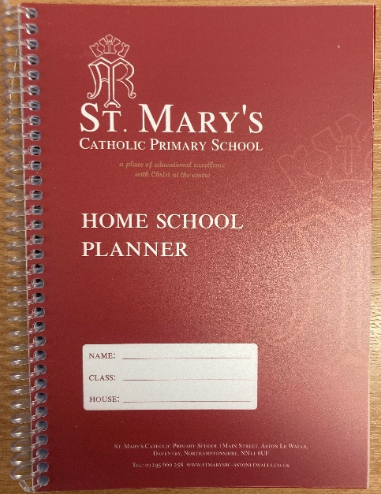

What does your child need to bring to school?
Water bottle (Everyday)
Book Folder / Planner (Everyday)
PE Kit – shorts, jogging bottoms, red t-shirt, warm jumper, trainers (Zeno) - Thursdays
Coat, hat etc (weather dependent)
Forest School kit – Tuesdays
Read Write Inc Bookbag Book (Everyday)
Bring PE and Forest School kit in on a Monday and take home Friday
Please ensure that everything is named so that we can return lost items.

Slide 5

The School Day
8:30 Arrive at school
8:45 Children line up when the bell rings
8:50 Registration
9:00 Session 1
10:15 Playtime
10:30 Session 2
12:00 Lunchtime
13:00 Session 3
15:00 End of school day
We pray 4 times a day: morning, before and after meals and at the end of the day

Slide 6
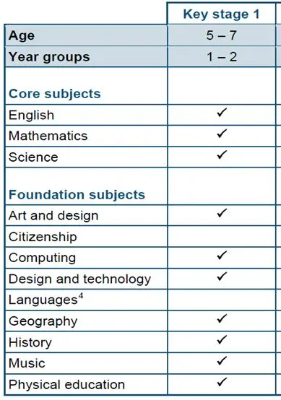
What will your child learn?
Notes:
Phonics: Read, Write Inc taught daily in year 1 and recapped for year 2
White Rose Maths: Parent section of website and an app

Slide 7
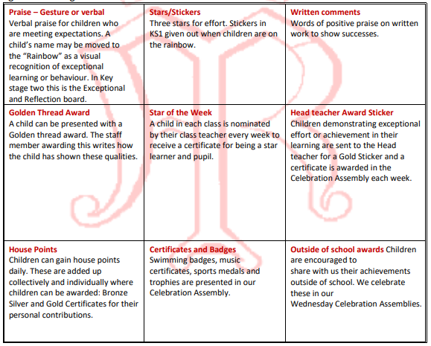
Celebrating Achievements

Slide 8
Sanction Steps
8 | Permanent exclusion
7 | Formal meeting with Governor, Head teacher, Class Teacher, Parents and Child Formal letter issued by Head teacher
6 | Fixed Term Exclusion (minimum ½ day including lunchtime) – formal letter issued Following a thorough investigation by the Senior Leadership Team any severe breech in behaviour including: physical aggression or insulting language/action will result in immediate action to Step 6
5 | Formal Meeting with Class Teacher, Parent, Child and Head teacher (after three Time In Letters issued)
4 | Child is sent to Headteacher for ‘time to reflect’ session at any point throughout the day
3 | Time IN Letter issued - sent home to parents for signature Despite reminders given If a child has continued to breach one of the Golden Rules then they will be kept in for break-time/lunch-time supervised by the class teacher or Head teacher
2 | Child’s name is moved onto the cloud and recorded
1 | Verbal warning

Slide 9
Important Information
Homework – handed in on Thursday
PE - Thursday afternoon
Forest School – Tuesday afternoon
Curriculum Letter
Reporting absences
Communication - weekly newsletter, Facebook/Twitter, School Planner
Friends of St Mary’s
Year 1 | Year 2
Daily reading | Daily reading
Weekly spellings (Test on Friday) | Weekly spellings (Test on Friday)
Worksheet English & Maths – Friday | Worksheet English & Maths – Friday
 | Multiples Marathon (Test on Friday)
Specific project – detailed in overview

Slide 10
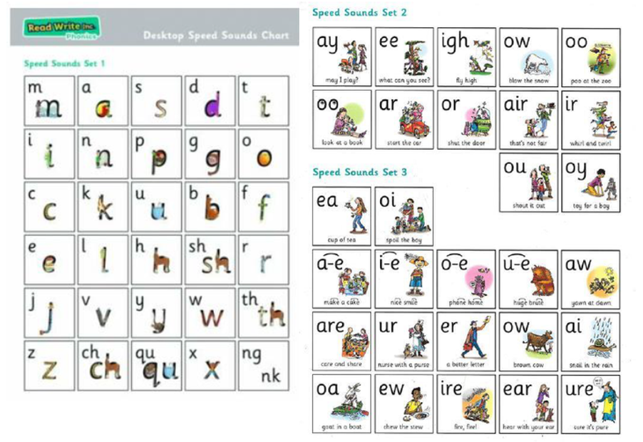


Read Write Inc. Phonics Year 1 & 2

Slide 11
Reading Vocabulary
At five years old:
Never read to – 4,622 words
1-2 times a week – 63,570 words
3-5 times a week – 169,520 words
Daily – 296,600 words
Five books a day – 1,483,300 words

Slide 12

Statutory Assessments
Year 1
Phonics Screening Check
Year 2
No SATS

Slide 13

Any questions?

