Slide 1




Parents Information Evening
Mrs Concannon

Slide 2



Mrs L. Concannon
Headteacher and Designated Safeguarding Lead
RE Lead
Art and Design Lead
Music Lead
Computing Lead
Catechist
Eucharistic Minister
Carpenters Class Teacher Yr 3/4
Mrs D. Morgan
Shepherds/Carpenters Class Teacher Yr 3/4 and Yr 5/6
Senior Teacher/SENCO
Mental Health Lead
Mrs S. Vale
Farmers Class Teacher Pre School and Reception
English Lead
Early Years Lead
Humanities Lead
Deputy Safeguarding Lead
Mr J. Causebrook
Shepherds Class Teacher Yr 5 and 6
Maths Lead
PE Lead
Mrs Fiona Clipson
Fishermen Class Teacher Year 1 and 2
EVC (educational visits Co-Ordinator)
Forest School Lead
Science Lead
Staffing
Mrs T. Smith: Music and RE support/ Substitute Teacher/ Catechist
Mrs D. Brimson: Teaching Assistant/ Staff Governor/ Midday Supervisor
Mrs S. Turner: Office Admin
Mrs M. Tetto- Pretti: Rising stars Assistant/ Teaching Assistant
Mrs K Hooper: Teaching Assistant
Miss Bothwell: Midday Supervisory Assistant/Level 3 Early years teaching assistant/ Morning club RS assisstent
Mrs McGinley: Teaching Assisstant/ After school club leader
Mrs L. King: Business Manager/Clerk to Governors
Fr. Michael: Parish Priest
Phil Lines: Sport PPA cover supervisor

Slide 3
Behaviour Policy and Rewards
Our behaviour policy is based strongly on pupils being rewarded for behaving in an appropriate manner.
•Each class follows a sunshine/ rainbow behaviour model, which is visually displayed in each room.
•All children start the day on the sunshine with the possibility of moving to a rainbow for exceptional behaviours or a cloud for wrong choices.
•In Key Stage 2, children have the green space for exceptional and the grey for reflection.

Slide 4
Sanction Steps
This shows how the sanctions progress from a low level to the more serious levels of behaviour.
•Sanction Step 1 - Verbal Warning
•Sanction Step 2 - Child’s name is moved onto the cloud and recorded.
•Sanction Step 3 - ‘Time In’ issued. Despite reminders being given, if a child has continued to breach one of the Golden Rules then they will be kept in for break-time/lunch-time and are supervised by the classteacher or Headteacher.
•Sanction Step 4 - Child is sent to Headteacher for ‘time to reflect’ session at any point throughout the day.
•Sanction Step 5 - Formal Meeting with Class Teacher, Parent, Child and Headteacher (after three Time In Letters issued).
•Sanction Step 6 - Fixed Term Exclusion (minimum ½ day including lunchtime) – formal letter issued. Following a thorough investigation by the Senior Leadership Team any severe breech in behaviour including: physical aggression or insulting language/action will result in immediate action to Step 6.
•Sanction Step 7 - Formal meeting with Governor, Headteacher, Class Teacher, Parents and Child. Formal letter issued by Headteacher.
Sanction Step 8 - Permanent Exclusion.

Slide 5
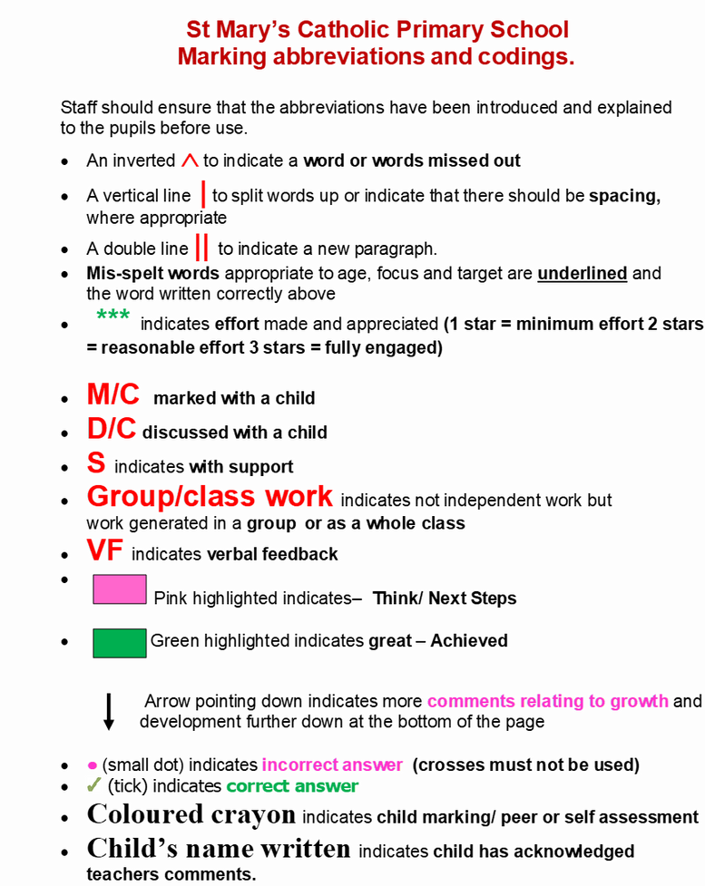
Marking Policy- Book Look Information

Slide 6
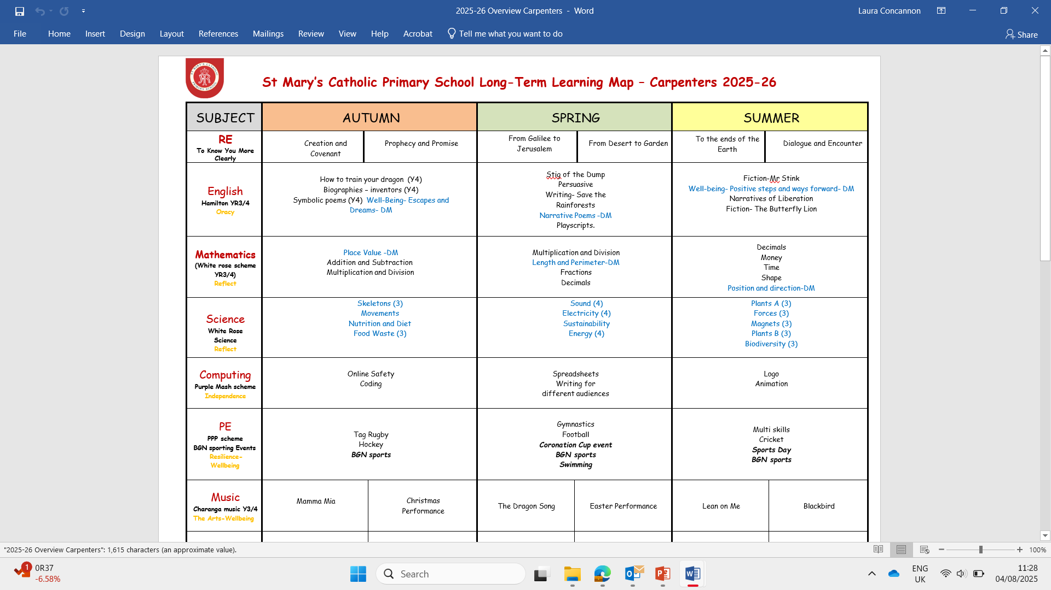

Slide 7
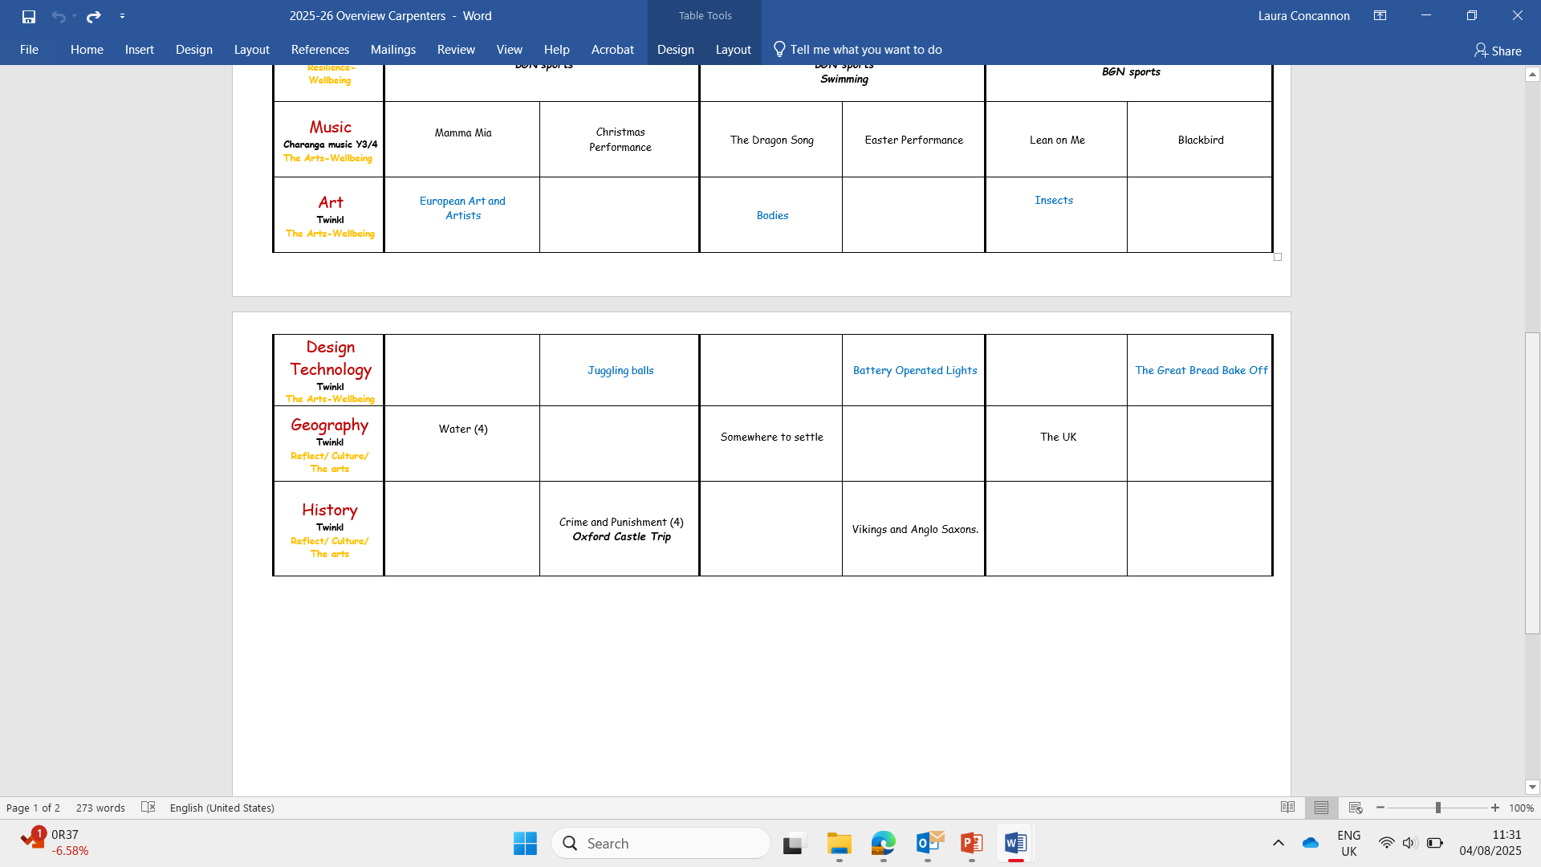

Slide 8
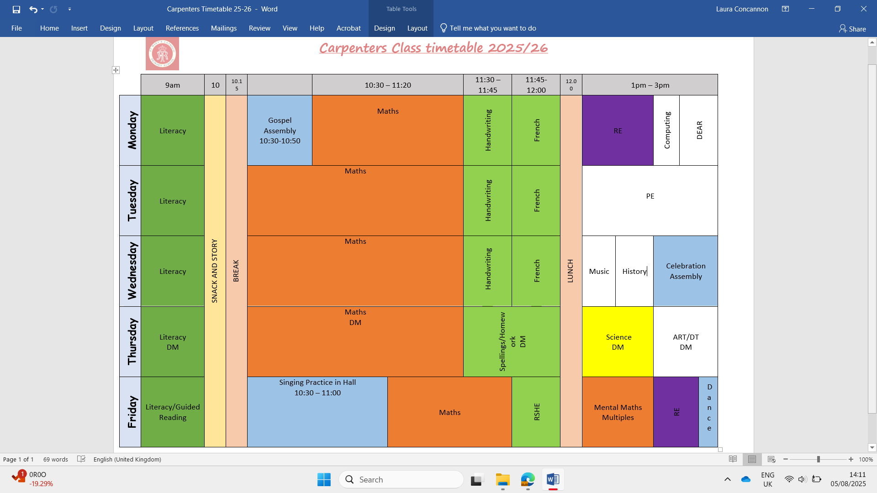
Timetable
BGN sports events…

Slide 9
Homework
The homework tasks that the children are expected to complete are as follows:
· Read their school reading book (daily)
· Practise spellings (weekly)
· Times table practise (weekly)
· One Maths/English task (weekly)
Homework will be set on a Friday and needs to be handed in on Thursday morning, the completed homework will be marked on this day, with a reward of a house point for handing it in.

Slide 10
Multiplication Check Year 4
  From the 2019/20 academic year onwards, all state-funded maintained schools and academies (including free schools) in England were required to administer an online multiplication tables check (MTC) to Year 4 pupils.
  The national curriculum specifies that pupils should be taught to recall the multiplication tables up to and including 12 × 12 by the end of Year 4.
  The purpose of the MTC is to determine whether pupils can recall their times tables fluently, which is essential for future success in mathematics.
Aim:
  It will help schools to identify pupils who have not yet mastered their times tables, so that additional support can be provided.
  Administration:
  Schools have a 3-week window to administer the MTC. Teachers will have the flexibility to administer the check to individual pupils, small groups or a whole class at the same time.

Slide 11
Multiplication Check Year 4
  There will be 25 questions worth one mark each. The questions will be in no particular order.
  Every question will follow the same format and will require the same type of response e.g. 4 x 8 = 32
  Children will have a maximum of six seconds to answer each question.
  There will be a three-second pause before the next question is displayed.
  The emphasis will be on the "6, 7, 8, 9 and 12 multiplication tables", with two to four questions in every test taken from each of the 6, 7, 8, 9 and 12 multiplication tables, meaning that between 18 and 22 questions will focus on KS2 content.
  There will be no question reversals in any test. For example, "3 × 8 would not appear in the same form as 8 × 3".
  Children will be randomly assigned a test. The system will provide a range of tests, equal in difficulty, but with different questions in different orders. No test should have more than 30 per cent of the same questions as another test.
  Children will be able to access a "practice area" in the run up to the test window in June.

Slide 12
Assessments
Teachers track the children in the following ways:
  Marking
  Termly PIRA and PUMA assessments
  Mental Arithmetic tests
  Multiple tests
  Spelling tests
  Completion of tracking sheets (termly)
Parents will be updated:
  Parents evening
  Interim Assessment report
  End of Year Report

Slide 13
What do I need?
  PE kit
  Coat
  Water Bottle
  Forest School Kit
  Medicines

